Slide 1


The Link Layer
COMPSCI 453 Computer Networks
Professor Jim Kurose
College of Information and Computer Sciences
University of Massachusetts
Introduction to the Link Layer
Error-detection and -correction Techniques
Multiple Access Links and Protocols
Switched Local Area Networks
Link Virtualization: a Network as a Link Layer
Data Center Networking
Retrospective: A Day in the Life of a Web Page Request
Class textbook:
Computer Networking: A Top-Down Approach (8th ed.)
J.F. Kurose, K.W. Ross
Pearson, 2020
http://gaia.cs.umass.edu/kurose_ross

Slide 2
Error detection
EDC: error detection and correction bits (e.g., redundancy)
D: data protected by error checking, may include header fields
datagram
datagram
Error detection not 100% reliable!
  protocol may miss some errors, but rarely
  larger EDC field yields better detection and correction
otherwise
all
bits in D’
OK
?
N
detected
error
d data bits
D
EDC
D’
EDC’
bit-error prone link

Slide 3
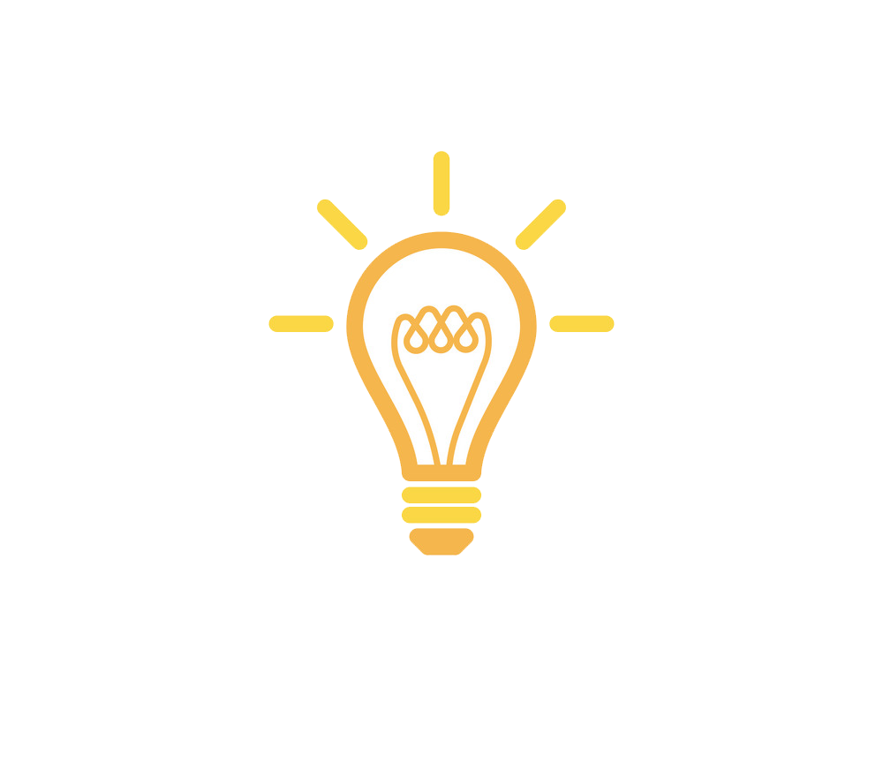
Parity checking
row parity
Two-D parity:
d_{1,1}
. . .
d_{1,j}
d_{1,j+1}
single bit parity:
detect single bit errors
d_{2,1}
. . .
d_{2,j}
d_{2,j+1}
. . .
. . .
. . .
. . .
d_{i,1}
. . .
d_{i,j}
d_{i,j+1}
column
parity
0111000110101011
1
d_{i+1,1}
. . .
d_{i+1,j}
d_{i+1,j+1}
d data bits
detect two-bit errors
detect and correct single bit errors without retransmission!
parity bit
Even parity: set parity bit so there is an even number of 1’s
At receiver:
compute parity of d+1 received bits, if not even, then error detected
can detect odd number of bit flips
no errors:
1 0 1 0 1
1
detected
and
correctable
single-bit
error:
1 0 1 0 1 1
1 1 1 1 0
0
1 0 1 1 0 0
parity
error
0 1 1 1 0
1
0 1 1 1 0 1
1 0 1 0 1
0
1 0 1 0 1 0
parity
error
* Check out the online interactive exercises for more examples: http://gaia.cs.umass.edu/kurose_ross/interactive/

Slide 4
Internet checksum (review, see section 3.3)
Goal: detect errors (i.e., flipped bits) in transmitted segment
sender:
treat contents of UDP segment (including UDP header fields and IP addresses) as sequence of 16-bit integers
checksum: addition (one’s complement sum) of segment content
checksum value put into UDP checksum field
receiver:
compute checksum of received segment
check if computed checksum equals checksum field value:
  not equal - error detected
  equal - no error detected. But maybe errors nonetheless? More later ….

Slide 5
Cyclic Redundancy Check (CRC)
more powerful error-detection coding
D: data bits (given, think of these as a binary number)
G: bit pattern (generator), of r+1 bits (given, specified in CRC standard)
r CRC bits
d data bits
D
R
bits to send
<D,R> = D 2^{r} XOR R
formula for these bits
*
sender: compute r CRC bits, R, such that <D,R> exactly divisible by G (mod 2)
  receiver knows G, divides <D,R> by G. If non-zero remainder: error detected!
  can detect all burst errors less than r+1 bits
  widely used in practice (Ethernet, 802.11 WiFi)

Slide 6
Cyclic Redundancy Check (CRC): example
G
Sender wants to compute R such that:
  D . 2^{r} XOR R = nG
1
0
1
0 1 1
1 0 0 1
1 0 1 1 1 0
0 0 0
1 0 0 1
1 0 1
D
2^{r} (here, r=3)
0 0 0
*
... or equivalently (XOR R both sides):
  D . 2^{r} = nG XOR R
1 0 1 0
1 0 0 1
1 1 0
... which says:
if we divide D . 2^{r} by G, we want remainder R to satisfy:
0 0 0
1 1 0 0
1 0 0 1
1 0 1 0
1 0 0 1
D.2^{r}
G
algorithm for
computing R
R = remainder [ ]
0 1 1
R
* Check out the online interactive exercises for more examples: http://gaia.cs.umass.edu/kurose_ross/interactive/

Slide 7

Link Layer
COMPSCI 453 Computer Networks
Professor Jim Kurose
College of Information and Computer Sciences
University of Massachusetts
Introduction to the Link Layer
Error-detection and -correction Techniques
Multiple Access Links and Protocols
Switched Local Area Networks
Link Virtualization: a Network as a Link Layer
Data Center Networking
Retrospective: A Day in the Life of a Web Page Request
Class textbook:
Computer Networking: A Top-Down Approach (8th ed.)
J.F. Kurose, K.W. Ross
Pearson, 2020
http://gaia.cs.umass.edu/kurose_ross
Video: 2020, J.F. Kurose, All Rights Reserved
Powerpoint: 1996-2020, J.F. Kurose, K.W. Ross, All Rights Reserved

